Slide 1
1 Corinthians 13

Slide 2
13 If I speak in the tongues of men and of angels, but have not love, I am a noisy gong or a clanging cymbal. ² And if I have prophetic powers, and understand all mysteries and all knowledge, and if I have all faith, so as to remove mountains, but have not love, I am nothing. ³ If I give away all I have, and if I deliver up my body to be burned, but have not love, I gain nothing.

Slide 3
⁴ Love is patient and kind; love does not envy or boast; it is not arrogant ⁵ or rude. It does not insist on its own way; it is not irritable or resentful; ⁶ it does not rejoice at wrongdoing, but rejoices with the truth. ⁷ Love bears all things, believes all things, hopes all things, endures all things.
⁸ Love never ends. As for prophecies, they will pass away; as for tongues, they will cease; as for knowledge, it will pass away. ⁹ For we know in part and we prophesy in part, ¹⁰ but when the perfect comes, the partial will pass away.

Slide 4
¹¹ When I was a child, I spoke like a child, I thought like a child, I reasoned like a child. When I became a man, I gave up childish ways. ¹² For now we see in a mirror dimly, but then face to face. Now I know in part; then I shall know fully, even as I have been fully known.
¹³ So now faith, hope, and love abide, these three; but the greatest of these is love.

Slide 5
The Temporary, but Critical Nature of Spiritual Gifts
χάρισμα (charisma) = “gift”
Spiritual gifts – for the upbuilding of the church (but their misuse destroys)
Some gifts ‘spectacular’. Others not spectacular. All essential for building up
Healing
Miracles
Prophecy
Knowledge
Other Languages
Interpretation of Languages
Mercy
Wisdom
Discernment
Faith
Evangelism
Pastoring
Apostleship
Teaching
Serving
Administration
Exhortation (encouragement)
Giving
The Lord is not looking for talented individuals to work for Him.
He’s looking for willing vessels for Him to work through.
Why did (over time) some Spiritual Gifts become ‘less apparent’?

Slide 6
The Temporary, but Critical Nature of Spiritual Gifts
χάρισμα (charisma) = “gift”
Spiritual gifts – for the upbuilding of the church (but their misuse destroys)
Some gifts ‘spectacular’. Others not spectacular. All essential for building up
Healing
Miracles
Prophecy
Knowledge
Other Languages
Interpretation of Languages
Mercy
Wisdom
Discernment
Faith
Evangelism
Pastoring
Apostleship
Teaching
Serving
Administration
Exhortation (encouragement)
Giving
The Lord is not looking for talented individuals to work for Him. He’s looking for willing vessels for Him to work through.
^{14:1} Pursue love, and earnestly desire the spiritual gifts, especially that you may prophesy

Slide 7
The Temporary, but Critical Nature of Spiritual Gifts
Spiritual gifts – for the upbuilding of the church (but their misuse destroys)
Some gifts ‘spectacular’. Others not spectacular. All essential for building up
χάρισμα (charisma) = “gift”
^{14:1} Pursue love, and earnestly desire the spiritual gifts, especially that you may prophesy
⁸ Love never ends. As for prophecies, they will pass away; as for tongues, they will cease; as for knowledge, it will pass away. ⁹ For we know in part and we prophesy in part, ¹⁰ but when the perfect comes, the partial will pass away.
Those with the gift of Knowledge, don’t know everything
Those with the gift of Prophecy don’t have a word for everybody
Spiritual gifts will be redundant when Jesus returns (they won’t be needed)

Slide 8
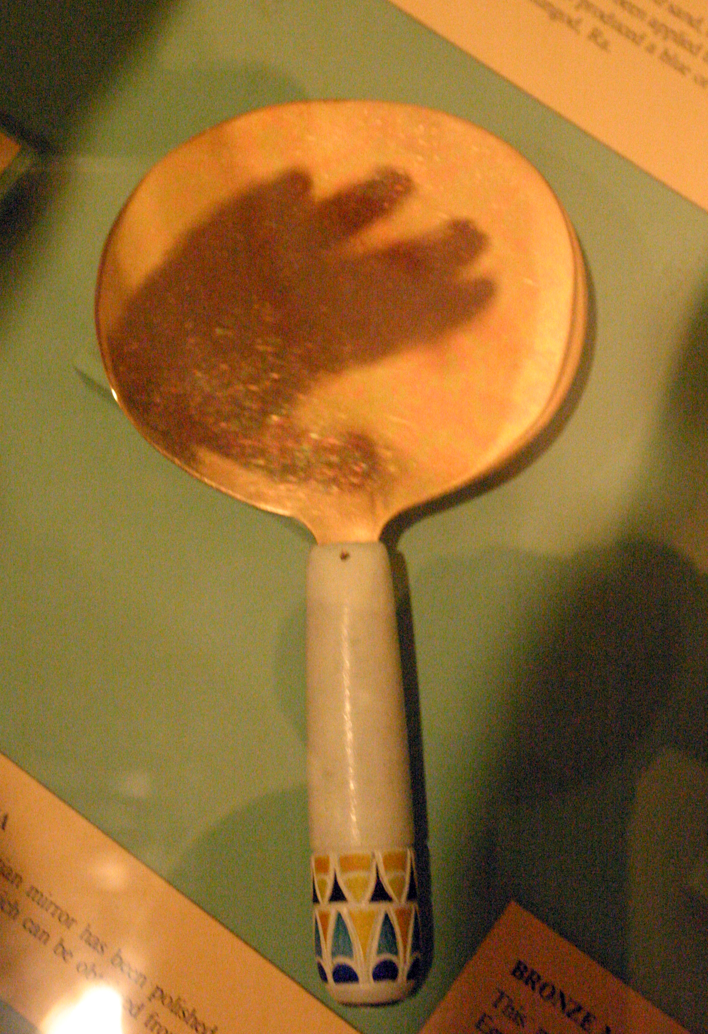
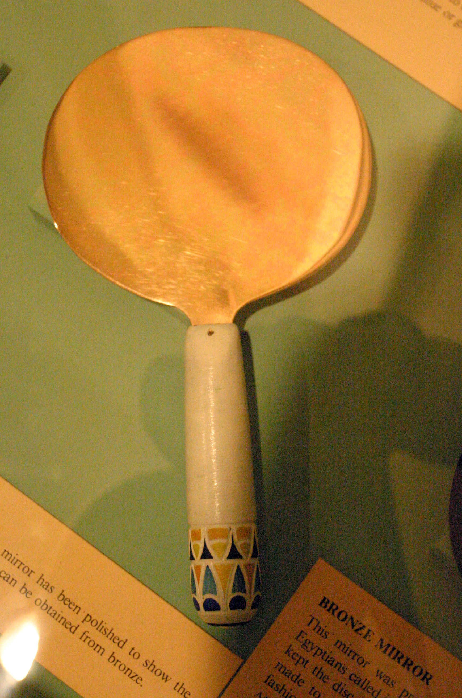

Slide 9
The Temporary, but Critical Nature of Spiritual Gifts
Spiritual gifts – for the upbuilding of the church (but their misuse destroys)
Some gifts ‘spectacular’. Others not spectacular. All essential for building up
χάρισμα (charisma) = “gift”
^{14:1} Pursue love, and earnestly desire the spiritual gifts, especially that you may prophesy
⁸ Love never ends. As for prophecies, they will pass away; as for tongues, they will cease; as for knowledge, it will pass away. ⁹ For we know in part and we prophesy in part, ¹⁰ but when the perfect comes, the partial will pass away.
Those with the gift of Knowledge, don’t know everything
Those with the gift of Prophecy don’t have a word for everybody
Spiritual gifts will be redundant when Jesus returns (they won’t be needed)
God knows us fully. When Jesus returns, we will know Him fully
But cessationists have an opposing view – “When the canon of the New Testament was formed, perfection had arrived & some gifts ceased”

Slide 10
The Temporary, but Critical Nature of Spiritual Gifts
Spiritual gifts – for the upbuilding of the church (but their misuse destroys)
Some gifts ‘spectacular’. Others not spectacular. All essential for building up
χάρισμα (charisma) = “gift”
^{14:1} Pursue love, and earnestly desire the spiritual gifts, especially that you may prophesy
Spiritual gifts will be redundant when Jesus returns (they won’t be needed)
God knows us fully. When Jesus returns, we will know Him fully
When a church earnestly desires spiritual gifts for the building up of the church, and prays for these gifts, at His discretion, God gives gifts
Beware!!! Gifts without Love or Order; Gifts with arrogance & feelings of spiritual superiority = messed up
Gifts with Love and order = Building up
A Truly Spiritual church is characterised by
Faith; Hope; and especially Love

